Slide 1
A Deep Learning Explainable Ensemble Framework
to obtain reliable Malaria detection using
microscopic images of blood smears
This study compares six deep-learning models for malaria classification from microscopic blood-smear cell images and uses Explainable AI to visualize image regions influencing predictions.
Presented By:
Md Abdullah Ibne Hayan (12322998)
Shahid Ansari (12321439)
1

Slide 2
Contents
1. Introduction
2. Literature Survey
3. Proposed Methodology
4. System Architecture / Framework
5. Results & Discussion
6. Comparative Analysis
7. Conclusion & Future Scope
8. References
2

Slide 3
Introduction
Background / Motivation
• WHO estimates 247 million people were infected with malaria in 2021 and 619,000 died globally.
• Conventional diagnosis uses manual microscopic analysis of Giemsa-stained blood smears by trained microscopists.
• Limitations: time consuming; skill-dependent accuracy; inter-observer variability and subjectivity; equipment cost; shortage of trained personnel.
Problem Statement
• Few extensive comparative studies evaluate multiple state-of-the-art architectures under the same experimental conditions.
• Many studies focus on classification accuracy rather than model interpretability and explainability.
Research Objectives
• Systematically compare six deep learning models.
• Evaluate accuracy, precision, recall, F1, confusion matrices, ROC/AUC and PR/AP.
• Use Grad-CAM to visualize discriminative regions.
• Investigate training dynamics, overfitting/underfitting and generalization.
Key Contributions
• YOLOv11 and VGG19 identified as the most effective architectures.
• Grad-CAM added for interpretable decision visualization and reliability.
3

Slide 4
Literature Survey
Existing Approaches & Findings
Traditional machine-learning methods have been applied to malaria classification using handcrafted image features.
CNN and transfer-learning models have demonstrated promising performance in detecting parasitized blood-smear images.
Ensemble learning techniques have been investigated to improve classification performance by combining multiple models.
Previous studies mainly emphasize classification performance, while systematic comparison and model reliability remain limited.
Research Gaps
Limited comparison of multiple deep-learning models under the same conditions.
Insufficient focus on model explainability.
Limited analysis of false positives and false negatives.
Lack of detailed investigation into overfitting, underfitting, and generalization.
Comparative Review
Previous studies mainly focus on improving malaria-classification performance using deep learning, ensemble methods, and explainable AI.
Research Motivation
To develop an explainable malaria-detection framework by comparing six deep-learning models and analyzing their predictions using multiple evaluation metrics and Grad-CAM visualizations.
4

Slide 5
Proposed Methodology
Dataset / Data Sources
• Kaggle Malaria Detection dataset: 27,558 microscopic red-blood-cell images.
• Two balanced classes: Parasitized and Uninfected.
Preprocessing
• Images resized to 224 × 224 pixels.
• Pixel values scaled for model input.
• Training augmentation used to improve robustness.
Dataset Partitioning
• Training: 16,534 images (60%).
• Validation: 5,512 images (20%).
• Testing: 5,512 images (20%).
Models Evaluated
• ResNet50, DenseNet201, EfficientNetB0, MobileNetV2,
Optimized VGG19 and YOLOv11.
Training Strategy
• Transfer learning and fine-tuning where applicable.
• Evaluation performed on the held-out test set.
5

Slide 6
System Architecture / Framework
Six models
VGG19 • DenseNet201 • EfficientNetB0
MobileNetV2 • Optimized ResNet50 • YOLOv11
27,558
blood-smear images
224×224
Normalize 0–1
Evaluation
Accuracy • Precision • Recall
F1 • ROC/AUC • PR/AP
Explainability
Grad-CAM heatmaps highlight image regions influencing a prediction; they do not precisely segment every parasite.
Training configuration
Adam • LR 0.001 • batch 32 • 20–30 epochs • early stopping
Implementation
Kaggle Notebook • TensorFlow 2.20.0 • GPU acceleration
Two-stage training
Frozen backbone → fine-tuning
lower LR 1e-4
6

Slide 7
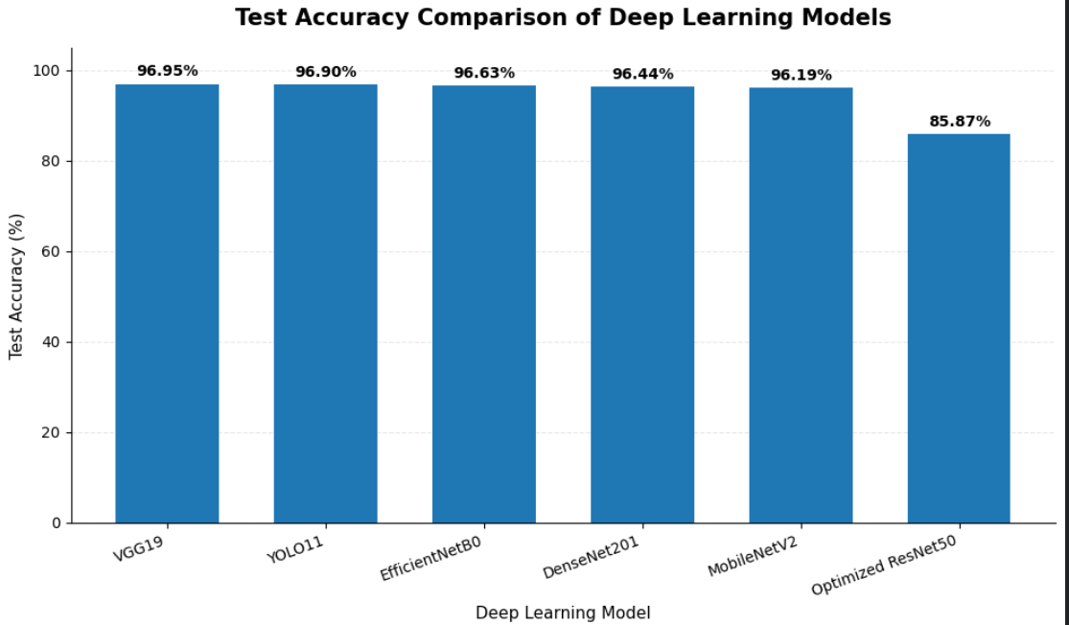
Results & Discussion
Experimental setup
• 27,558 microscopic cell images; 60/20/20 train/validation/test split.
• Six deep-learning classifiers evaluated on the same task.
• Metrics: accuracy, precision, recall, F1, ROC-AUC and average precision.
Test-set accuracy
• VGG19: 96.95%
• YOLOv11: 96.90%
• EfficientNetB0: 96.63%
• DenseNet201: 96.44%
• MobileNetV2: 96.19%
• Optimized ResNet50: 85.87%
VGG19 achieved the highest measured test accuracy in this experiment.
YOLOv11 showed the strongest ROC-AUC and average precision.
7

Slide 8
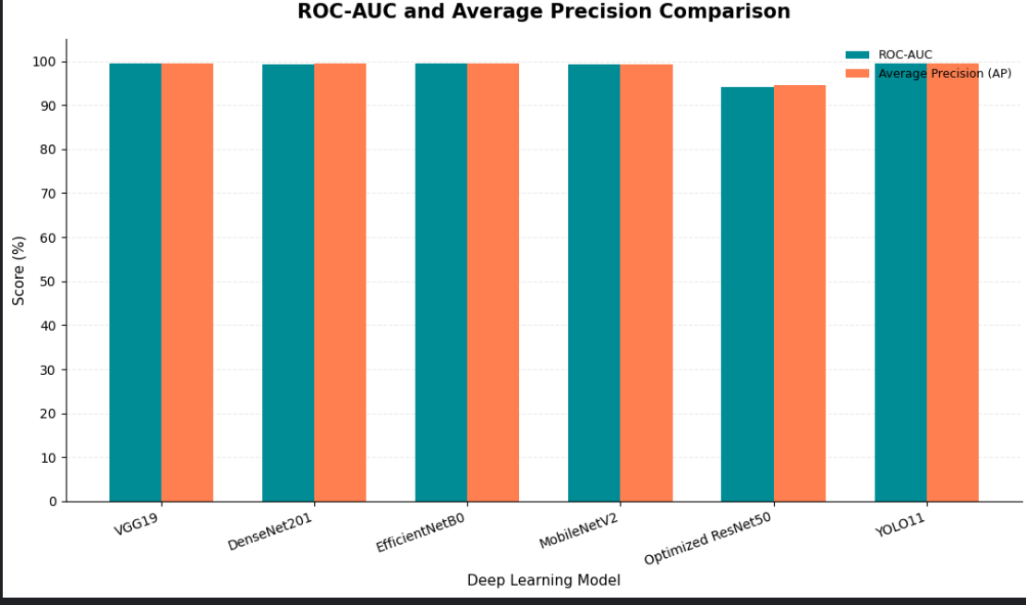
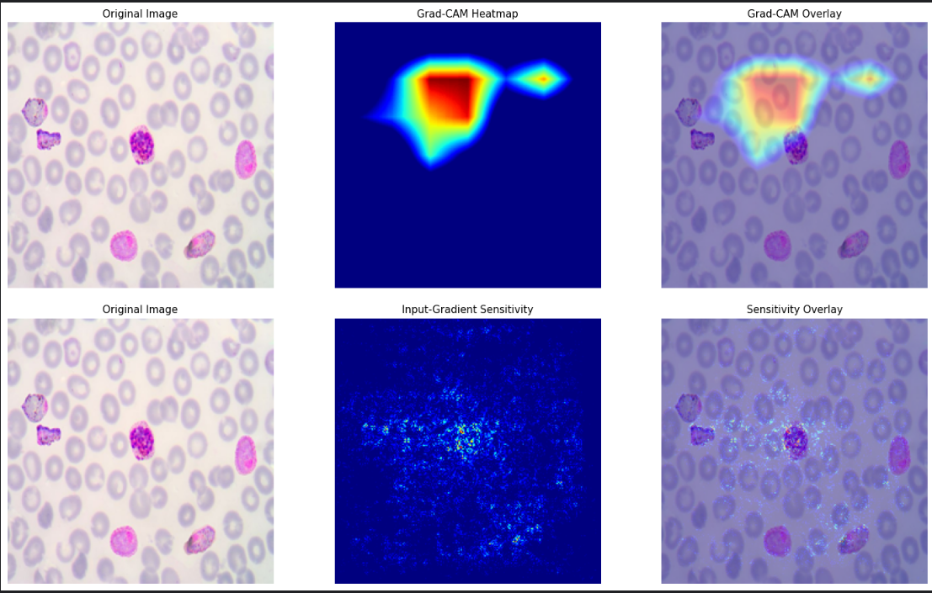
Comparative Analysis
TEST-SET COMPARISON
VGG19
Accuracy 96.95% | F1 96.96%
Precision 96.75% | Recall 97.17%
YOLOv11
Accuracy 96.90% | F1 96.88%
Precision 97.33% | Recall 96.44%
EfficientNetB0
Accuracy 96.63% | F1 96.60%
Precision 97.35% | Recall 95.86%
Interpretation
All five alternatives exceeded 96% accuracy except the optimized ResNet50 baseline (85.87%). YOLOv11 led ROC-AUC (99.55%) and average precision (99.58%).
Grad-CAM is an attention explanation—not a precise parasite segmentation mask.
8

Slide 9
Conclusion & Future Scope
Key Findings
• VGG19 achieved the highest test accuracy: 96.95%.
• YOLOv11 achieved 96.90% accuracy, 99.55% ROC-AUC and 99.58% AP.
• EfficientNetB0, DenseNet201 and MobileNetV2 also exceeded 96% accuracy.
• Optimized ResNet50 reached 85.87%, indicating that architecture and training choices matter.
Explainable AI
• Grad-CAM: Highlights influential regions in the image using convolutional feature-map gradients.
• Input-Gradient Sensitivity: Identifies pixels where changes can influence the model’s prediction.
• Visual Interpretation: Both methods provide complementary insights into the model’s decision-making process.
Limitations
• Evaluation used one dataset and one held-out test split.
• External validation and robustness testing are still required.
• The model is a research demonstration, not a clinical diagnostic tool.
Future Work
• Validate across laboratories, staining protocols and imaging devices.
• Improve localization and evaluate calibration and error cases.
9

Slide 10
References
[1] N. E. Ross et al., “Automated image processing method for the diagnosis and classification of malaria on thin blood smears,” Medical and Biological Engineering and Computing, vol. 44, no. 5, pp. 427–436, 2006.
[2] D. K. Das et al., “Machine learning approach for automated screening of malaria parasite using light microscopic images,” Micron, vol. 45, pp. 97–106, 2013.
[3] G. Madhu, “Computer vision and machine learning approach for malaria diagnosis in thin blood smears from microscopic blood images,” in Machine Learning for Intelligent Decision Science, Springer, pp. 191–209, 2020.
[4] G. Shekar, S. Revathy, and E. K. Goud, “Malaria detection using deep learning,” Proc. 4th Int. Conf. Trends Electronics and Informatics (ICOEI), pp. 746–750, 2020.
[5] A. Maqsood et al., “Deep malaria parasite detection in thin blood smear microscopic images,” Applied Sciences, vol. 11, no. 5, p. 2284, 2021.
[6] M. H. D. Alnussairi and A. A. Ibrahim, “Malaria parasite detection using deep learning algorithms based on (CNNs) technique,” Computers and Electrical Engineering, vol. 103, p. 108316, 2022.
[7] S. Kumar et al., “Optimized deep CNN with rotation driven features for malaria parasite detection,” Neural Computing and Applications, vol. 37, no. 30, pp. 25515–25534, 2025.
[8] A. S. Bashir et al., “Adaptive Marine Predators Algorithm for Optimizing CNNs in Malaria Detection,” Engineering Proceedings, vol. 124, no. 1, p. 25, 2026.
[9] M. Bhuiyan and M. S. Islam, “A new ensemble learning approach to detect malaria from microscopic red blood cell images,” Sensors International, vol. 4, p. 100209, 2023.
[10] S. R. Nayak et al., “An ensemble artificial intelligence enabled MIoT for automated diagnosis of malaria parasite,” Expert Systems, vol. 39, no. 4, p. e12906, 2022.
[11] M. H. Asif et al., “Malaria parasitic detection using a new Deep Boosted and Ensemble Learning framework,” Complex & Intelligent Systems, vol. 10, no. 4, pp. 4835–4851, 2024.
[12] G. Marques, A. Ferreras, and I. de la Torre Diez, “An ensemble based approach for automated medical diagnosis of malaria using EfficientNet,” Multimedia Tools and Applications, vol. 81, no. 19, pp. 28061–28078, 2022.
[13] S. Paul et al., “A novel ensemble weight assisted Yolov5 based deep learning technique for the localization and detection of malaria parasites,” Electronics, vol. 11, no. 23, p. 3999, 2022.
[14] D. Sukumarran et al., “An automated malaria cells detection from thin blood smear images using deep learning,” Tropical Biomedicine, vol. 40, no. 2, pp. 208–219, 2023.
[15] H. K. Ragb, I. T. Dover, and R. Ali, “Deep convolutional neural network ensemble for improved malaria parasite detection,” Proc. IEEE Applied Imagery Pattern Recognition Workshop (AIPR), 2020.
[16] F. Grignaffini et al., “Computer aided diagnosis systems for automatic malaria parasite detection and classification: A systematic review,” Electronics, vol. 13, no. 16, p. 3174, 2024.
[17] A. Kumar et al., “MOSQUITO NET: a deep learning based CADx system for malaria diagnosis along with model interpretation using GradCam and class activation maps,” Expert Systems, vol. 39, no. 7, p. e12695, 2022.
[18] A. Gaouar et al., “Explainable ai for early malaria detection using stacked lstm and attention mechanisms,” Informatics in Medicine Unlocked, vol. 57, p. 101667, 2025.
[19] R. Parveen et al., “Trustworthy deep learning for malaria diagnosis using explainable artificial intelligence,” Scientific Reports, 2025.
[20] R. K. Patel and S. Vahora, “XMal CNN: An Explainable Deep Neural Model for Automated Malaria Detection from Blood Smear Images,” Journal of Innovative Image Processing, vol. 7, no. 3, pp. 739–758, 2025.
[21] M. F. Ahamed et al., “Improving Malaria diagnosis through interpretable customized CNNs architectures,” Scientific Reports, vol. 15, no. 1, p. 6484, 2025.
[22] A. N. R. Shree et al., “Integrating Transfer Learning and XAI for Trustworthy Malaria Diagnosis in Clinical Decision Support,” Proc. 9th Int. Conf. Computational System and Information Technology for Sustainable Solutions (CSITSS), 2025.
[23] N. A. Hroub et al., “Explainable deep learning diagnostic system for prediction of lung disease from medical images,” Computers in Biology and Medicine, vol. 170, p. 108012, 2024.
[24] M. Z. A. S. Tanvir, S. Singla, A. K. M. S. Karim, M. S. E. Islam, H. K. Mittal and S. S. Kang, “Breast Cancer Diagnosis Using Machine Learning: A Comparative Analysis of Classifiers,” 2026 Eight International Conference on Computational Intelligence and Communication Technologies (CCICT), Sonepat, Haryana, India, 2026, pp. 93–99, doi: 10.23919/CCICTCPS00010.2026.00024.
[25] M. Z. A. S. Tanvir, I. Kaur, A. K. M. S. Karim, S. Arifin and U. Mondal, “SimCLR-Based Self-Supervised Learning for Effective Feature Representation,” 2025 IEEE 4th International Conference on Technology, Engineering, Management for Societal impact using Marketing, Entrepreneurship and Talent (TEMSMET), New Delhi, India, 2025, pp. 1–5, doi: 10.1109/TEMSMET65536.2025.11467503.
10

Slide 11
THANK YOU
Questions & Discussion
11

